Slide 1
Household Pet Ownership and Differentiations in the Human Gut Microbiome
Shadab Sharif

Slide 2
Introduction & Background
Human Microbiome
Essential component of our overall health and well-being. It is a complex ecosystem of trillions of microorganisms that reside within and on our bodies, influencing everything from our immune system to our mental health. The composition of the microbiome can change throughout a person's lifetime and is influenced by a variety of factors(diet, age, genetics, hygiene, and perhaps even pets)
Possible Positive Impact of Pets
Studies conducted in the 1980s demonstrated a link between the intestinal bacteria of pets and their owners. Recent studies have focused on the impact of early life exposure to pets on the diversity and richness of the human gut microbiome in infants and young children, revealing positive effects. Additionally, recent years have provided us with new tools to profile physiological samples at the molecular level. High-throughput sequencing has allowed us to create a deeper understanding of microbiome composition of the human gut.

Slide 3
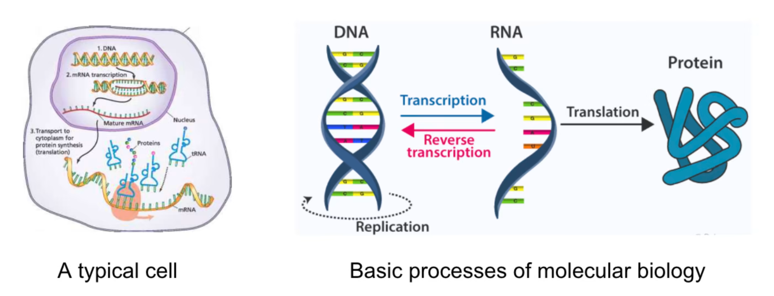
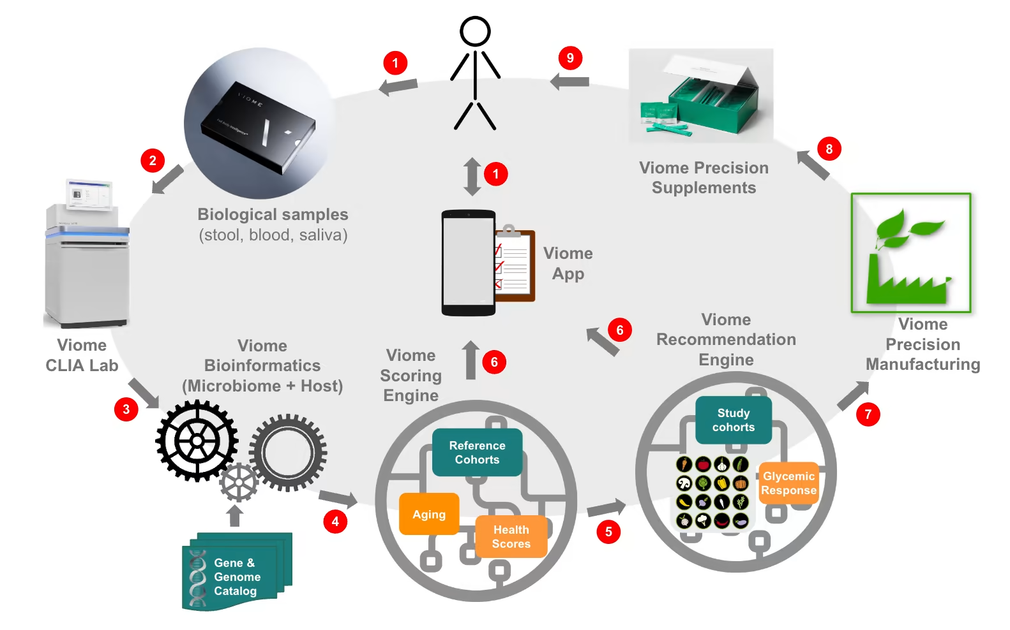
Introduction & Background

Slide 4
Can we tell the difference in people gut microbiomes depending on pet ownership status?
What health indicators can one observe based molecular profiling and pet ownership status?

Slide 5
Cohort
Subset of 3101 customers with available information to pet ownership
1922 of kits w/ pets, 1179 of kits w/o pets
The data was further filtered to assure that the sample analysis process was consistent across all samples, specifically the lab and bioinformatics processes were the same across all samples.
 | Female | Male | Female [%] | Male [%]
18- | 13 | 16 | 44.83% | 55.17%
18-27 | 38 | 21 | 64.41% | 35.59%
27-55 | 978 | 688 | 58.70% | 41.30%
55+ | 956 | 391 | 70.97% | 29.03%
All | 1985 | 1116 | 64.01% | 35.99%

Slide 6
Dataset
Each kit was represented with the following data:
Microbiome profile(detected genus expressions w/ the relative abundance)
Pet ownership label
Age
Sex

Slide 7
Data Preparation and Analysis steps
Implemented a set of steps in python to ingest data and format it suitable for further analysis
Step 1: Combine kit attributes and taxonomy (genus) data
Step 2: Initial Analysis of Association of Genus and Pet Label
No obvious patterns emerged from this approach due to an overlap of taxonomy signals across both groups, which led to step 3 analysis
Step 3: Feature engineering and relative enrichment
Relative change in taxonomy between the two groups.
Focus on subset of taxa with robust signals and indicative of differences between the groups.

Slide 8
Methods
Given input in the following format (Kit, Taxa/Genus, Relative Activity, Pet Label)
Log2 Fold Change for each unique Taxa
Compute the Average Relative Activity for all kits of pet owners
Compute the Average Relative Activity for all kits of non pet owners
Compute log2 of the ratio between the two means (ignore taxa where either of the means is 0)
Robustness Analysis
Split the dataset into 5 random groups
Compute Log2 Fold Change for each split as a buff
Age Group Analysis
Split the dataset into 4 different groups based on age (Under 18, 18-27, 27-55, 55+)
Compute Log2 Fold Change for each group

Slide 9
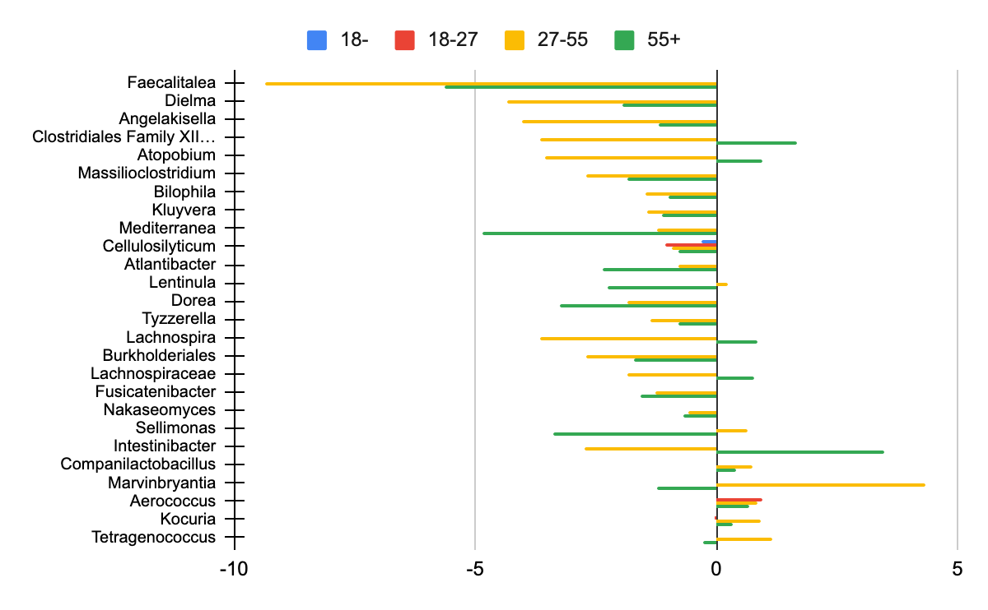
Results - Genus Log2 fold change (filtered for robust taxa & level)
Non Pet Owners
Pet Owners

Slide 10
Results & Discussion 1
Based on subset of taxa that consistently and repeatedly showed strong direction in the log2 fold change value
Analysis of directionality and significance of each age group
We identified 6 genera that are more prominently expressed in owners and 20 genera in non owners. Of these 26 when we look at the age groups, we find that 9 of them had a change of direction. 24 of them had only been in 2 of the age groups.

Slide 11
Results & Discussion 2
Literature survey of biological relevance of identified taxa
Evidence in literature that associates various genus with diseases and conditions and in most of the cases, the direction was towards non owners. Pet owners usually had decreased signals within the disease/infection markers.
In addition to that, another group of genus was associated with unfavorable profiles and diet and healthy guts and managing metabolic conditions such as diabetes (Intestinibacter)
Further analysis could provide more insight but the differences in the direction and age groups/ absence of signal in some age groups is a interesting topic to explore. For example, Atopobium is associated with a bacterial vaginosis and within our dataset, the 55+ population has a higher female to male ratio which could explain the change in signal between age groups.

Slide 12
Summary + Future Work
Data Limitations
We did not have a full representation of demographics (eg. Age Groups)
We used a higher level taxa classification (genus)
The size of the population (around 3,000) may not be large enough to be representative
Method Improvements
Factoring in additional data features (medical history, rural vs urban, type of pet, …)
Refine/Different Interpretations of molecular profile data (taxonomy at species level, abundance computation)
Other methods for feature engineering & modeling
Potential Applications
Diagnostic; Improve gut microbiome profiling
Therapeutic; Potential targets & condition management/monitoring

Slide 13
References for Human Microbiome & Previous Studies
References for Genera Analysis and Understanding
Caugant D. A., Levin B. R., Selander R. K. (1984). Distribution of multilocus genotypes of Escherichia coli within and between host families. J. Hyg. 92, 377–384. 10.1017/S0022172400064597
David, L., Maurice, C., Carmody, R. et al. Diet rapidly and reproducibly alters the human gut microbiome. Nature 505, 559–563 (2014). https://doi.org/10.1038/nature12820
Francino MP. Antibiotics and the Human Gut Microbiome: Dysbioses and Accumulation of Resistances. Front Microbiol. 2016 Jan 12;6:1543. doi: 10.3389/fmicb.2015.01543. PMID: 26793178; PMCID: PMC4709861
Kates AE, Jarrett O, Skarlupka JH, Sethi A, Duster M, Watson L, Suen G, Poulsen K, Safdar N. Household Pet Ownership and the Microbial Diversity of the Human Gut Microbiota. Front Cell Infect Microbiol. 2020 Feb 28;10:73. doi: 10.3389/fcimb.2020.00073. PMID: 32185142; PMCID: PMC7058978.
O'Toole PW, Jeffery IB. Gut microbiota and aging. Science. 2015 Dec 4;350(6265):1214-5. doi: 10.1126/science.aac8469. PMID: 26785481
Se Jin Song, Christian Lauber, Elizabeth K Costello, Catherine A Lozupone, Gregory Humphrey, Donna Berg-Lyons, J Gregory Caporaso, Dan Knights, Jose C Clemente, Sara Nakielny, Jeffrey I Gordon, Noah Fierer, Rob Knight (2013) Cohabiting family members share microbiota with one another and with their dogs eLife 2:e00458 https://doi.org/10.7554/eLife.00458
Tun H. M., Konya T., Takaro T. K., Brook J. R., Chari R., Field C. J., et al. (2017). Exposure to household furry pets influences the gut microbiota of infants at 3–4 months following various birth scenarios. Microbiome 5:40 10.1186/s40168-017-0254-x
Guindo, Cheick Oumar, et al. “A Tetragenococcus Halophilus Human Gut Isolate.” Current Research in Microbial Sciences, 16 Feb. 2022, www.ncbi.nlm.nih.gov/pmc/articles/PMC8866149/.
Williams, R. E. O., et al. “Aerococcus, a New Bacterial Genus.” Microbiologyresearch.org, 1 June 1953, www.microbiologyresearch.org/content/journal/micro/10.1099/00221287-8-3-475?crawler=true.
West, Kiana A., et al. “Multi-Angle Meta-Analysis of the Gut Microbiome in Autism Spectrum Disorder: A Step toward Understanding Patient Subgroups.” Nature News, 11 Oct. 2022, www.nature.com/articles/s41598-022-21327-9.
Wai, A C H, et al. “Complete Genome Sequence of Kluyvera SP.. CRP, a Cellulolytic Strain Isolated from Red Panda Feces (Ailurus Fulgens).” Microbiology Resource Announcements, 21 Apr. 2022, www.ncbi.nlm.nih.gov/pmc/articles/PMC9022541/.
Quantao Ma a, et al. “Investigation of Gut Microbiome Changes in Type 1 Diabetic Mellitus Rats Based on High-Throughput Sequencing.” Biomedicine &amp; Pharmacotherapy, 24 Jan. 2020, www.sciencedirect.com/science/article/pii/S0753332220300639.
“Lachnospira.” Lachnospira - an Overview | ScienceDirect Topics, www.sciencedirect.com/topics/agricultural-and-biological-sciences/lachnospira. Accessed 30 May 2023.
Cuevas-Sierra A;Romo-Hualde A;Aranaz P;Goni L;Cuervo M;Martínez JA;Milagro FI;Riezu-Boj JI; “Diet- and Sex-Related Changes of Gut Microbiota Composition and Functional Profiles after 4 Months of Weight Loss Intervention.” European Journal of Nutrition, pubmed.ncbi.nlm.nih.gov/33591390/. Accessed 30 May 2023.
“Human Gut Microbiome Atlas.” Msp_1264c - Species | Microbiome Atlas, www.microbiomeatlas.org/species.php?species_msp=msp_1264c. Accessed 30 May 2023.
Kasai, Chika, et al. “Comparison of Human Gut Microbiota in Control Subjects and Patients with Colorectal Carcinoma in Adenoma: Terminal Restriction Fragment Length Polymorphism and next-Generation Sequencing Analyses.” Oncology Reports, 1 Jan. 2016, www.spandidos-publications.com/10.3892/or.2015.4398.
Agnello, Melissa, et al. “Gut Microbiome Composition and Risk Factors in a Large Cross-Sectional IBS Cohort.” BMJ Open Gastroenterology, 6 Apr. 2020, www.ncbi.nlm.nih.gov/pmc/articles/PMC7254124/.

Slide 14
